Slide 1
Analyzing Algorithms
Text
Chapters 2

Slide 2
Analyzing Algorithms
goal: predicting resources that an algorithm requires
  memory, communication bandwidth, hardware,
  computational time
  compare several candidate algorithms, identify
  most efficient one

Slide 3
Analyzing Algorithms
one-processor, random-access machine (RAM)
  instructions executed one after another, no concurrent
  operations
  common instructions:
    arithmetic (+, -, *, /, %, ⎣ ⎦, ⎡ ⎤)
    data movement (load, store, copy)
    control (branch, subroutine call and return)
  do not consider memory hierarchy
elementary (primitive) operation: execution time can be bounded above by a constant depending only on the particular implementation—the machine, the programming language, etc.

Slide 4
Efficiency of an algorithm
Efficiency
  Time, space, energy
  Measured as a function of the size of the instances considered
Input Size
  The size of an instance/input
    corresponds formally the number of the bits needed to represent the instance on a computer
    A less formal definition: any integer that in some way measures the number of components in an instance
      For example, sorting, graphs
    For problems involving integers, we use value rather than size
Running time
  The number of primitive operations executed in terms of input size.
mathematic tools include combinatorics, probability theory,
identify most significant terms in a formula

Slide 5
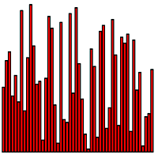
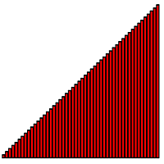


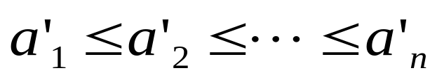
Sorting as Example
Algorithm:
  well-defined computational procedure that transforms input into output
  steps for the computer to follow to solve a problem
instance
Sorting Problem:
  Input: A sequence of n numbers
  Output: A permutation (reordering) of the input sequence such that:

Slide 6
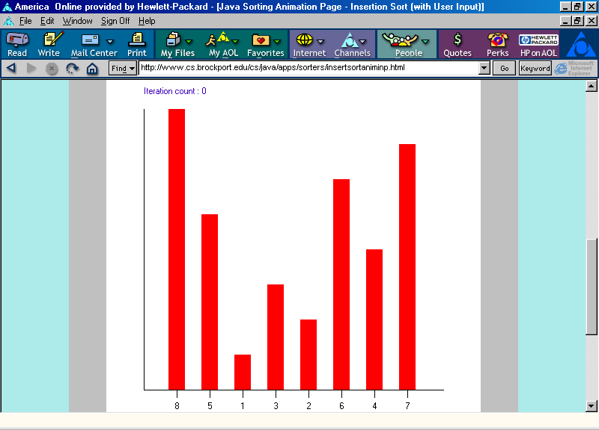
Insertion Sort Animation
Finding a place for item with value 5 in position 1:
Swap item in position 0 with item in position 1.
http://www.cs.brockport.edu/cs/java/apps/sorters/insertsortaniminp.html

Slide 7
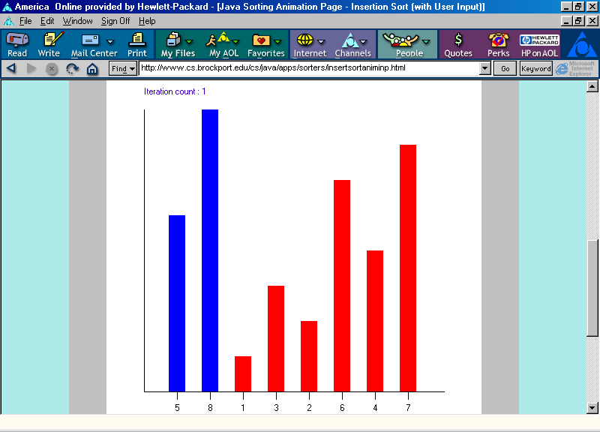
Insertion Sort Animation
Positions 0 through 1 are now in non-decreasing order.
http://www.cs.brockport.edu/cs/java/apps/sorters/insertsortaniminp.html

Slide 8
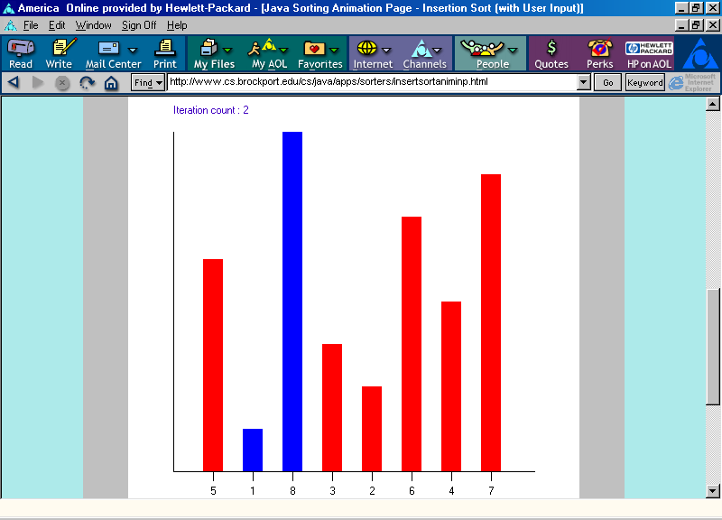
Insertion Sort Animation
Finding a place for item with value 1 in position 2:
Swap item in position 1 with item in position 2.
http://www.cs.brockport.edu/cs/java/apps/sorters/insertsortaniminp.html

Slide 9
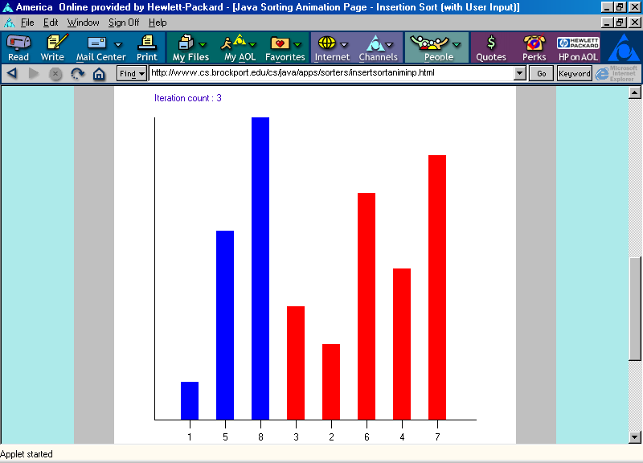
Insertion Sort Animation
Finding a place for item with value 1:
Swap item in position 0 with item in position 1.
Positions 0 through 2 are now in non-decreasing order.
http://www.cs.brockport.edu/cs/java/apps/sorters/insertsortaniminp.html

Slide 10
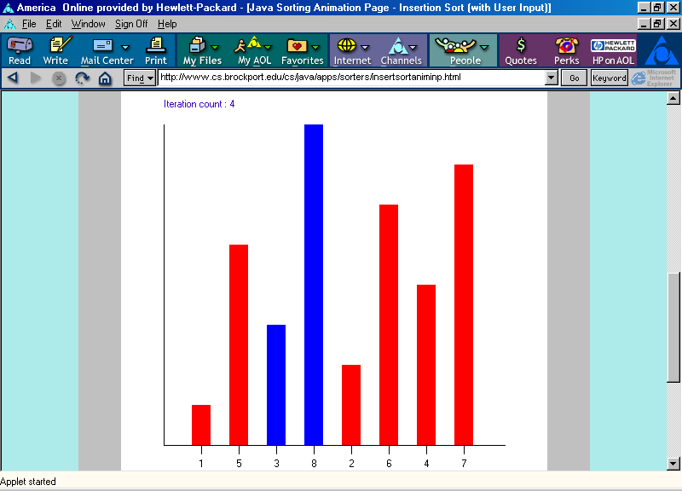
Insertion Sort Animation
Finding a place for item with value 3 in position 3:
Swap item in position 2 with item in position 3.
http://www.cs.brockport.edu/cs/java/apps/sorters/insertsortaniminp.html

Slide 11
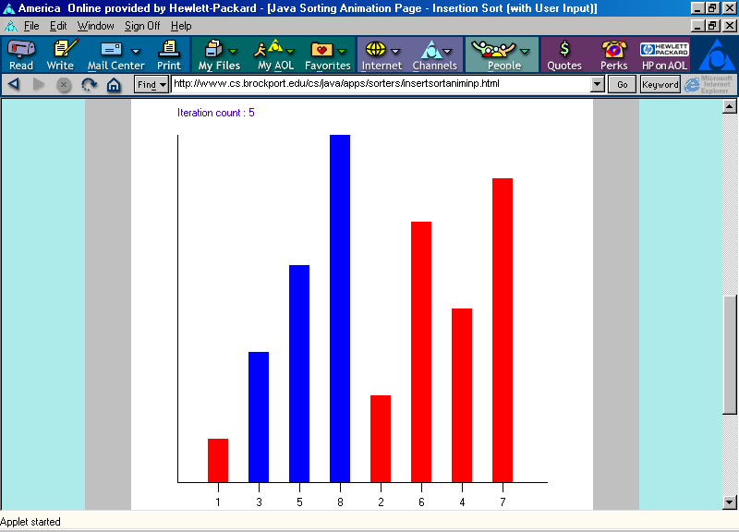
Insertion Sort Animation
Finding a place for item with value 3:
Swap item in position 1 with item in position 2.
http://www.cs.brockport.edu/cs/java/apps/sorters/insertsortaniminp.html

Slide 12
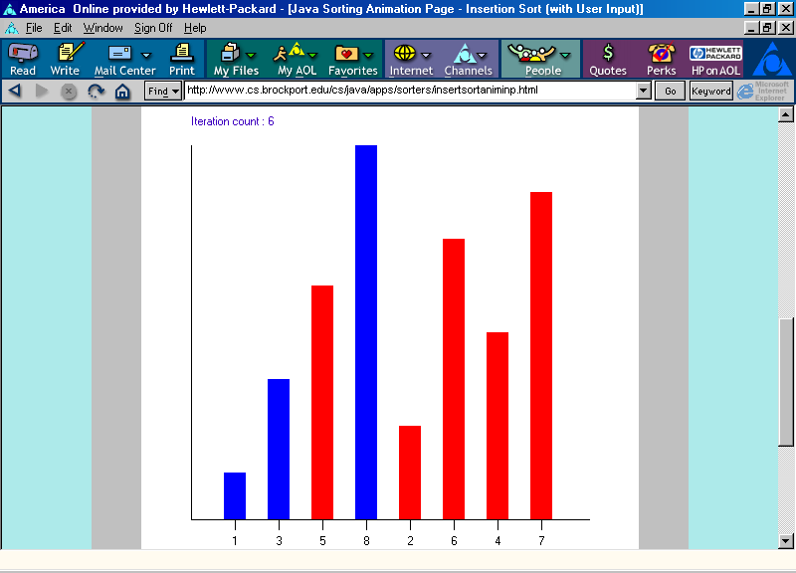
Insertion Sort Animation
Positions 0 through 3 are now in non-decreasing order.
http://www.cs.brockport.edu/cs/java/apps/sorters/insertsortaniminp.html

Slide 13
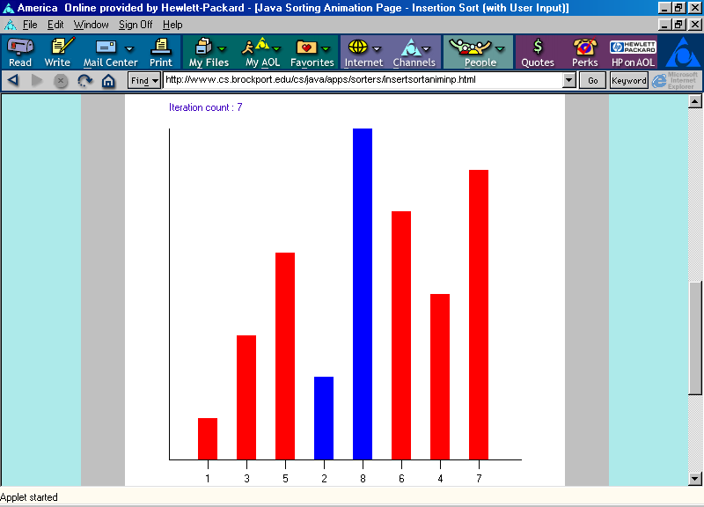
Insertion Sort Animation
Finding a place for item with value 2 in position 4:
Swap item in position 3 with item in position 4.
http://www.cs.brockport.edu/cs/java/apps/sorters/insertsortaniminp.html

Slide 14
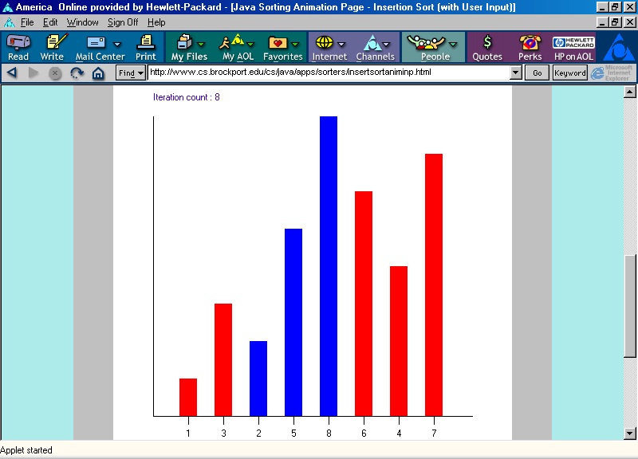
Insertion Sort Animation
Finding a place for item with value 2:
Swap item in position 2 with item in position 3.
http://www.cs.brockport.edu/cs/java/apps/sorters/insertsortaniminp.html

Slide 15
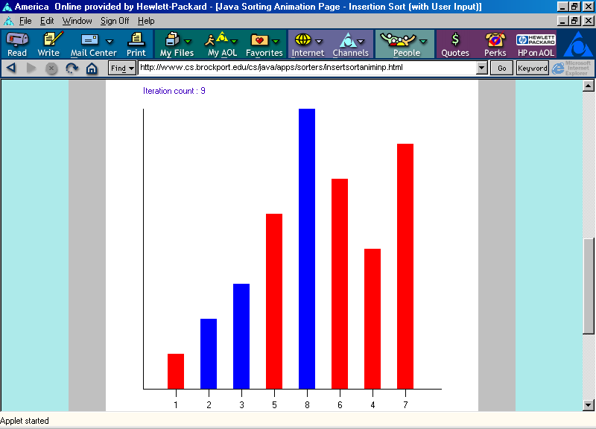
Insertion Sort Animation
Finding a place for item with value 2:
Swap item in position 1 with item in position 2.
http://www.cs.brockport.edu/cs/java/apps/sorters/insertsortaniminp.html

Slide 16
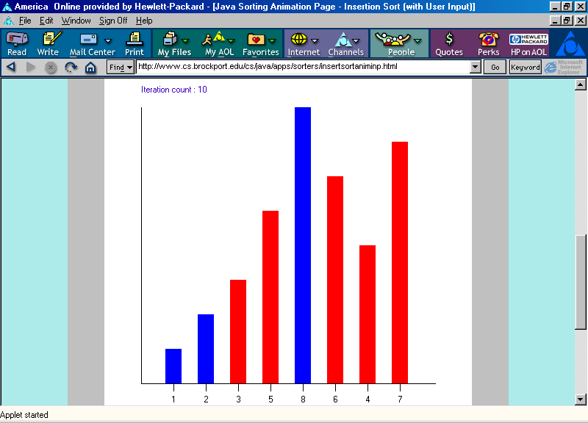
Insertion Sort Animation
Positions 0 through 4 are now in non-decreasing order.
http://www.cs.brockport.edu/cs/java/apps/sorters/insertsortaniminp.html

Slide 17
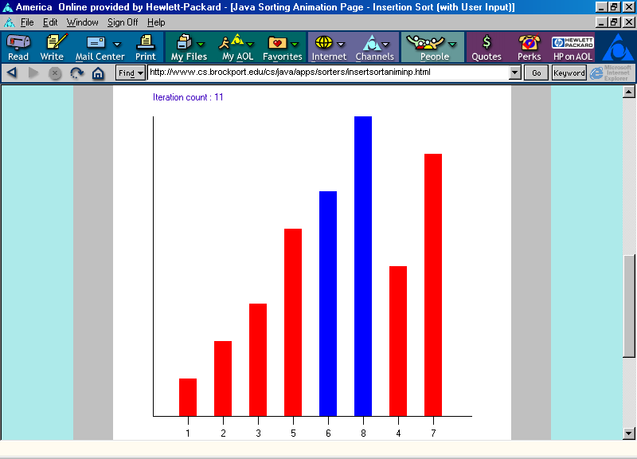
Insertion Sort Animation
Finding a place for item with value 6 in position 5:
Swap item in position 4 with item in position 5.
http://www.cs.brockport.edu/cs/java/apps/sorters/insertsortaniminp.html

Slide 18
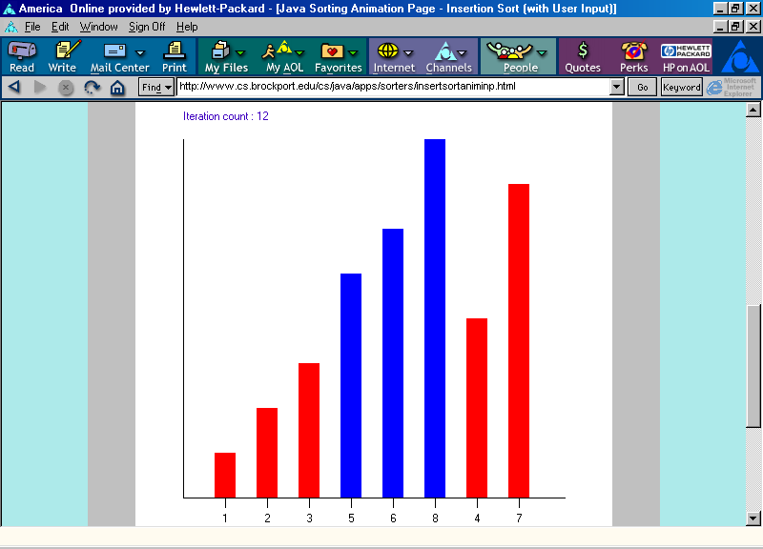
Insertion Sort Animation
Positions 0 through 5 are now in non-decreasing order.
http://www.cs.brockport.edu/cs/java/apps/sorters/insertsortaniminp.html

Slide 19
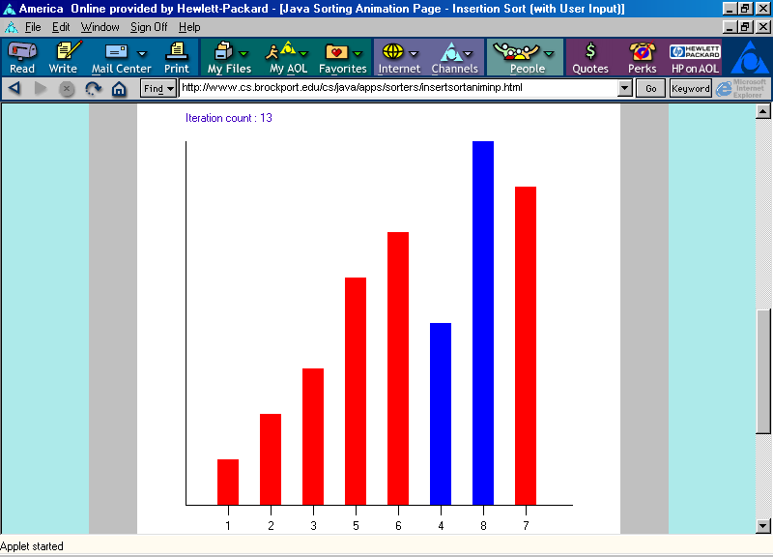
Insertion Sort Animation
Finding a place for item with value 4 in position 6:
Swap item in position 5 with item in position 6.
http://www.cs.brockport.edu/cs/java/apps/sorters/insertsortaniminp.html

Slide 20
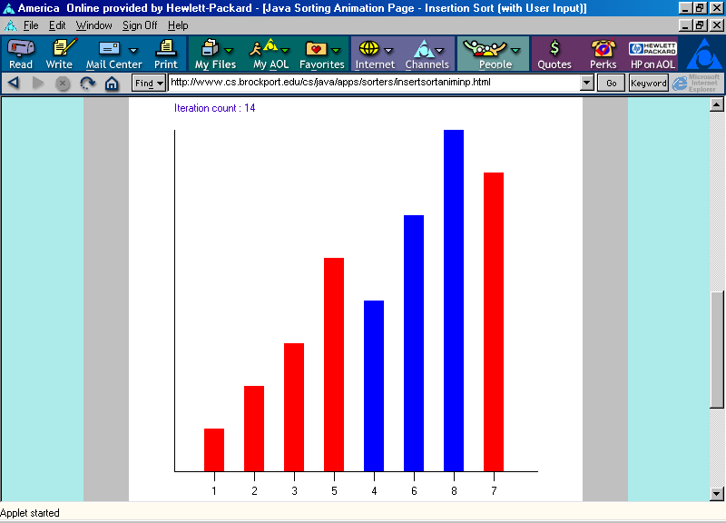
Insertion Sort Animation
Finding a place for item with value 4:
Swap item in position 4 with item in position 5.
http://www.cs.brockport.edu/cs/java/apps/sorters/insertsortaniminp.html

Slide 21
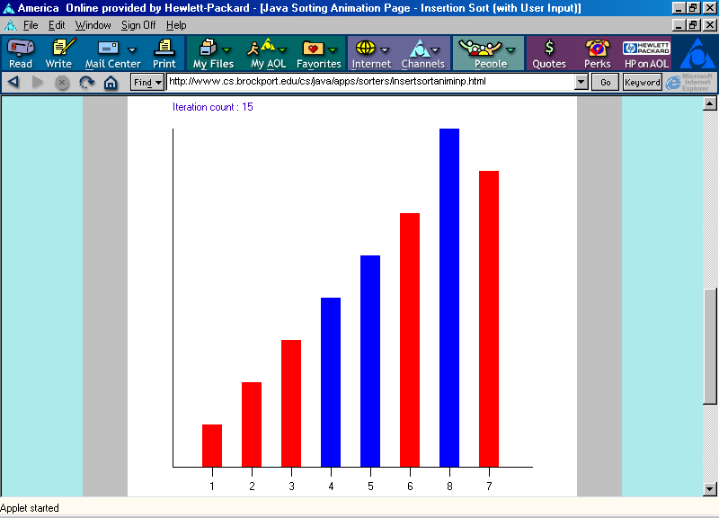
Insertion Sort Animation
Positions 0 through 6 are now in non-decreasing order.
http://www.cs.brockport.edu/cs/java/apps/sorters/insertsortaniminp.html

Slide 22
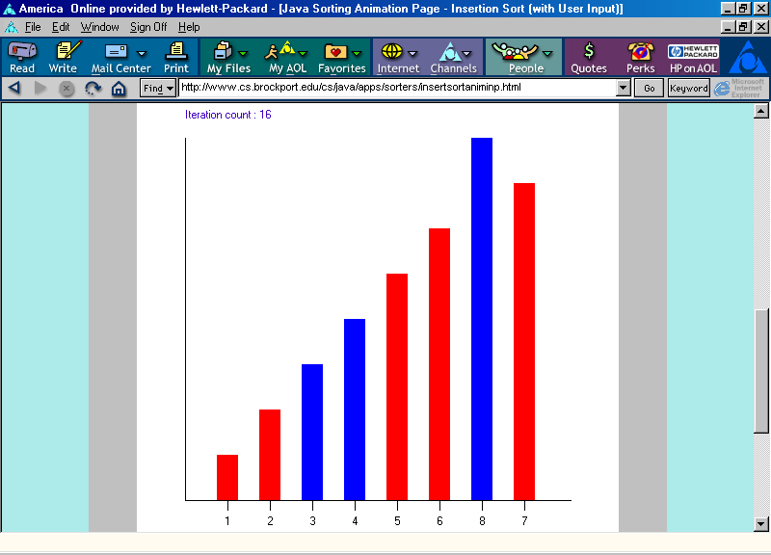
Insertion Sort Animation
Finding a place for item with value 7 in position 7:
Swap item in position 6 with item in position 7.
http://www.cs.brockport.edu/cs/java/apps/sorters/insertsortaniminp.html

Slide 23
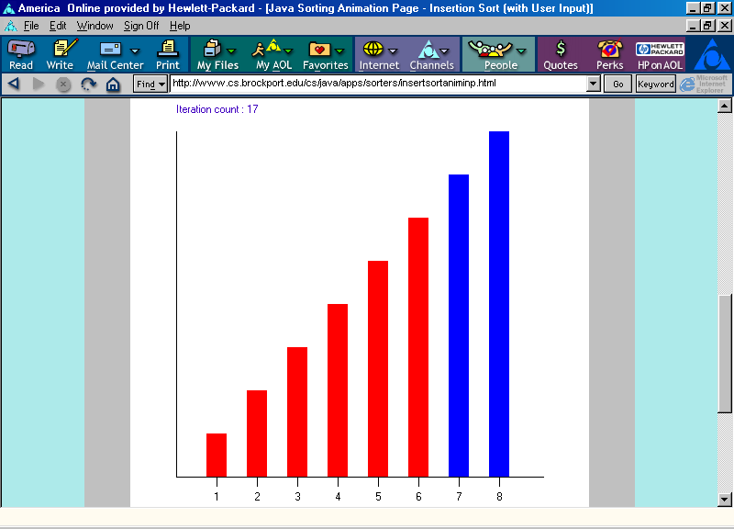
Insertion Sort Animation
Positions 0 through 7 are now in non-decreasing order.
http://www.cs.brockport.edu/cs/java/apps/sorters/insertsortaniminp.html

Slide 24
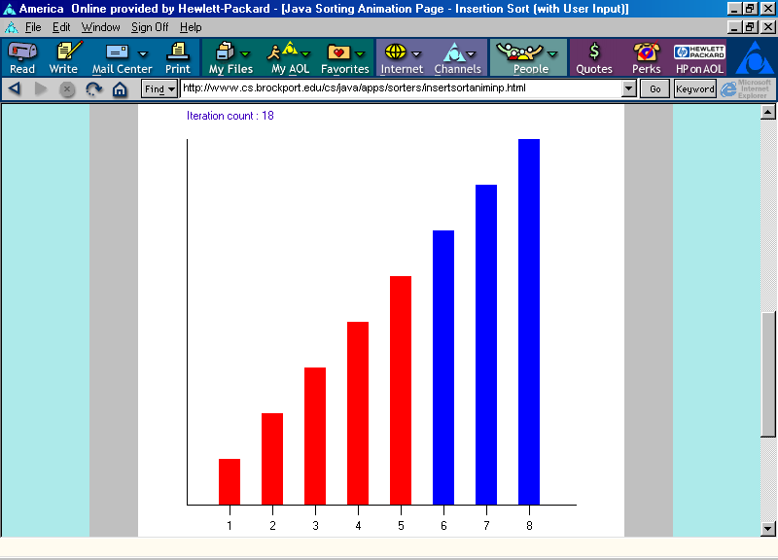
Insertion Sort Animation
Positions 0 through 7 are now in non-decreasing order.
http://www.cs.brockport.edu/cs/java/apps/sorters/insertsortaniminp.html

Slide 25
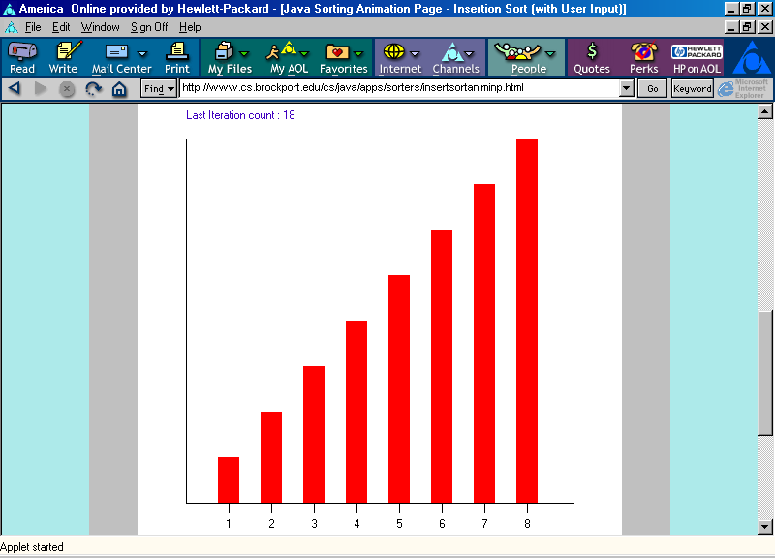
Insertion Sort Animation
Positions 0 through 7 are now in non-decreasing order.
http://www.cs.brockport.edu/cs/java/apps/sorters/insertsortaniminp.html

Slide 26


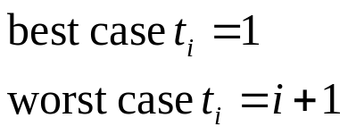
Insertion sort analysis
void insertionSort(int A[], int n)
{
int i, j, tmp;
cost times
for (i=1; i<n; i++) { c₁ n
tmp=A[i]; c₂ n-1
j = i-1; c₄ n-1
while (j>=0 && tmp<A[j]) { c₅
A[j+1] = A[j]; c₆
j--; c₇
}
A[j+1] = tmp; c₈ n-1
}
}

Slide 27

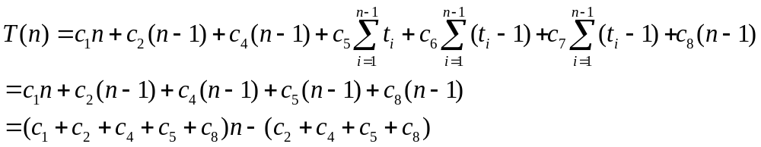
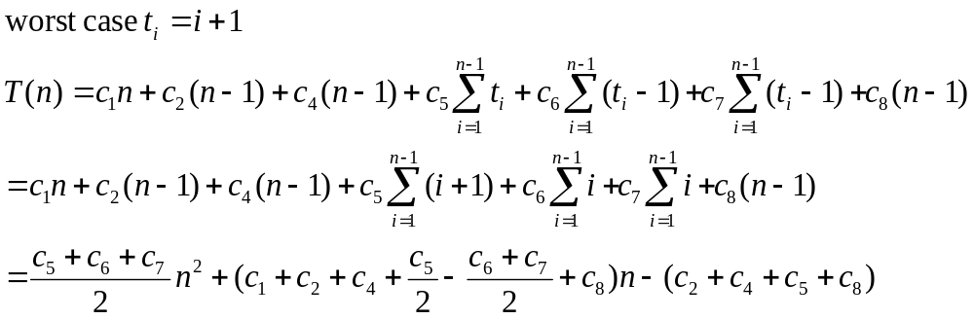
Insert sort cost

